Slide 1






HEALTHHUB
AI+ WEBSITE
Elderly, Remote, Convenience
Presentation by
Date
GROUP 1
QIN TIAN & XU YI
29 NOV 2024

Slide 2


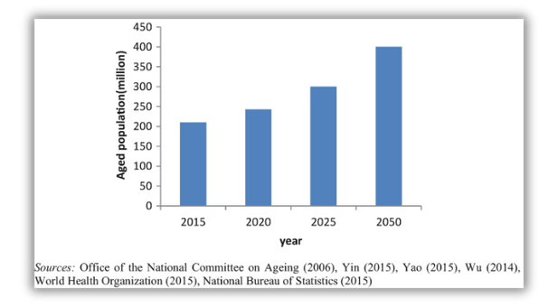
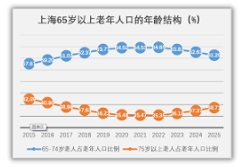

OUR MOTIVATION
WHY HEALTH HUB MATTERS
EXISTING PROBLEM:
The aging population issue is becoming increasingly severe and widespread.EG, in Shanghai, by the end of 2023, the number of registered residents aged 60 and above reached 5.68 million, accounting for 37.4% of the total population. Consequently, addressing digital aging has become increasingly urgent.
EXISTING PLATFORM:
LinkOlder/National Elderly Health Education Service Platform/Shanghai Elderly Care Service Platform
focus on solely on elderly care services(government Sponsoring organization), which is important.
-> also empower the elderly to independently search for disease-related information, access medical consultation channels, and connect with peers for better community interaction.

Slide 3












STEPS ELDERLY INDIVIDUALS TAKE
WHEN SEEKING MEDICAL CARE
01. IDENTIFYING HEALTH CONCERNS
02. RESEARCHING HEALTHCARE OPTION
03. GATHERING INFORMATION
04. MAKING APPOINTMENTS
Symptom Recognition
Assessing Severity
NLP Based
Specialized Departments
Hospital Selection
Electronic Medical Record
Medication Information
Scheduling Visits
Managing Multiple Appointments
05. CONSULTING HEALTHCARE PROVIDERS
06. FOLLOWING UP
07. ACCESSING SUPPORT & INFORMATION
Medication Management
Monitoring Health Progress
Recording Medical History
In-Person Visits
Remote Consultations
Educational Resources
Community Support

Slide 4
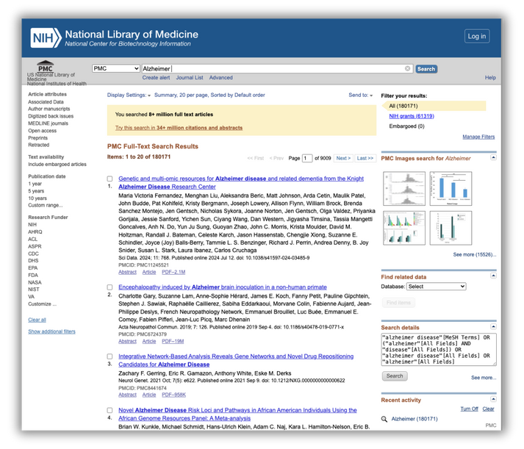
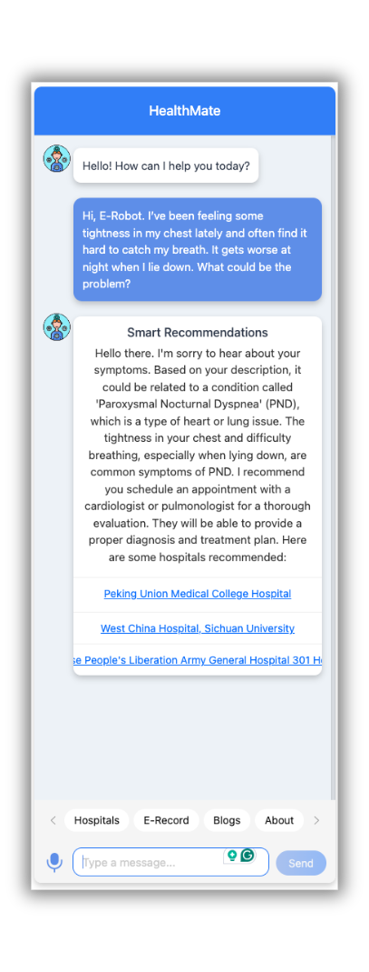

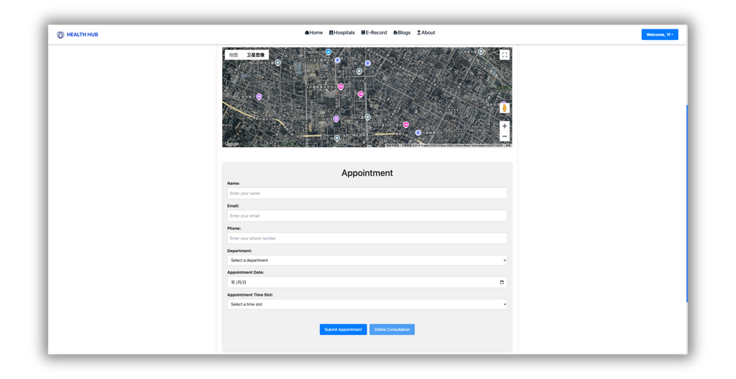

HEALTH ROBOT
USE CUSTOMIZED CHATBOT
Powerd by ChatGPT, the state-of-the-art NLP model that allows developers to build and integrate their own chat bots
Obtain common disease diagnosis-related report to fine tune models.
https://pmc.ncbi.nlm.nih.gov
Interaction between the BOT and various web pages
Query and redirect
Patient asks a question related to a disease ->
Query the category of the disease ->
Recommend hospitals that have specialized clinics for that category of disease, which users can click to redirect.
32 research papers from the National Health Commission (NHC) covering elderly diseases such as Alzheimer's Disease, Dementia, Parkinson's Disease, and Cardiovascular Diseases...

Slide 5


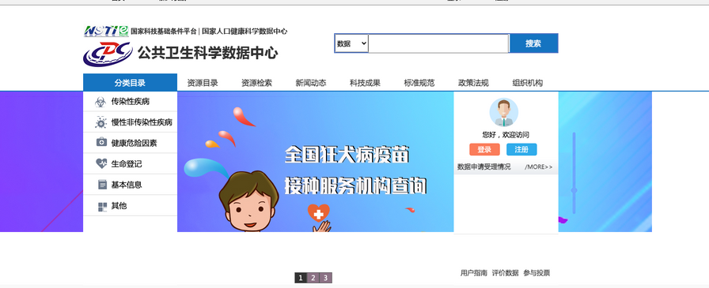
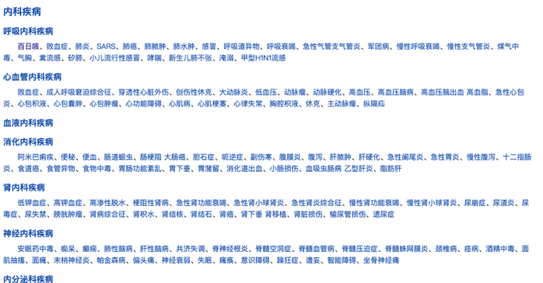

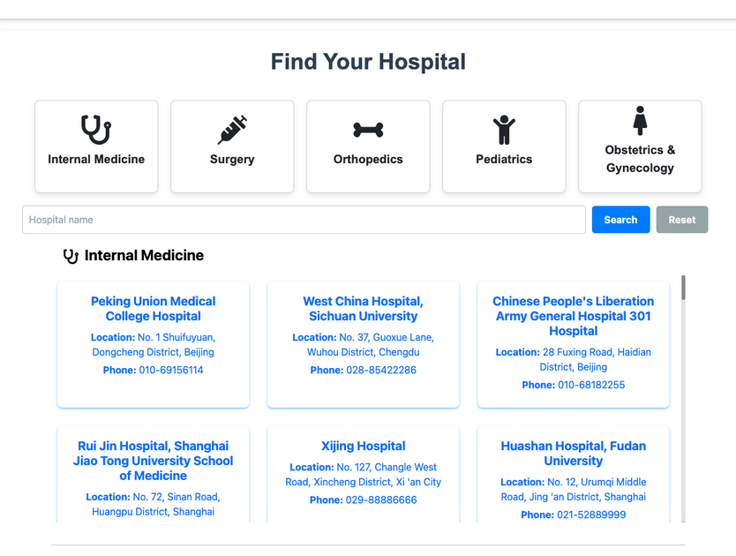

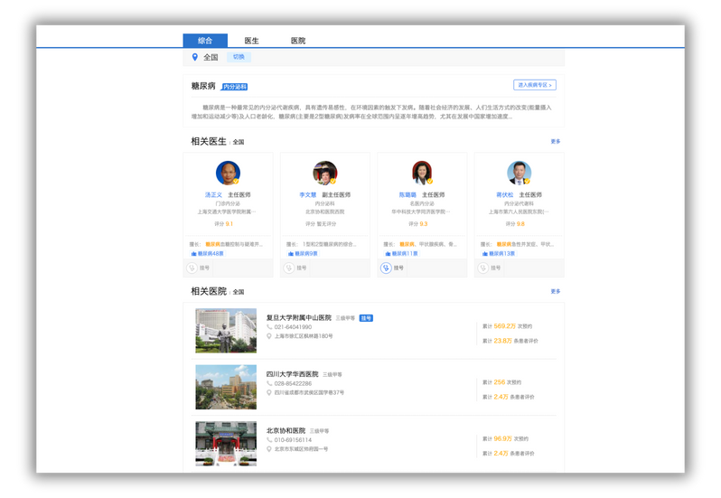

Special clinic
Crawl the “authentic” specialized departments of major hospitals
across China on WeDoctor, providing users with options to choose from.
https://www.phsciencedata.cn/Share/
Step 1: Scrape diseases and common disease classifications.
Step 2: Crawl the national specialty clinics corresponding to the disease.
https://www.guahao.com/hospital/

Slide 6

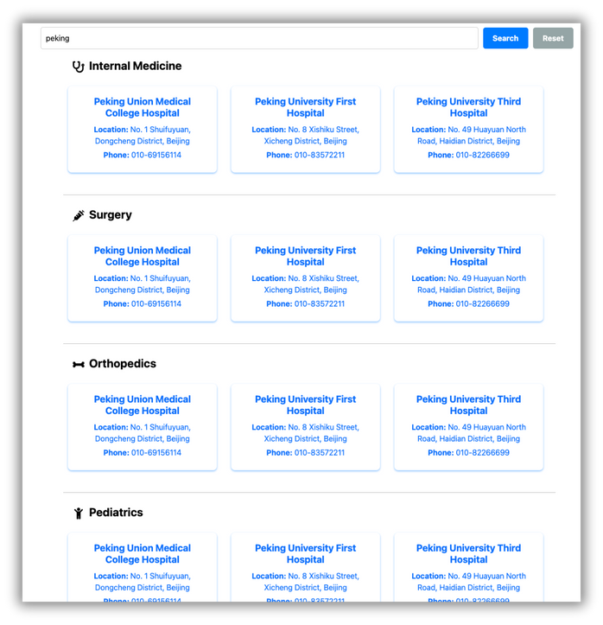
Special clinic
Use the clinic to select categories or direct fuzzy search (you can filter any area you want to visit)
Crawl the “authentic” specialized departments of major hospitals
across China on WeDoctor, providing users with options to choose from.
Hospitals after filtering

Slide 7
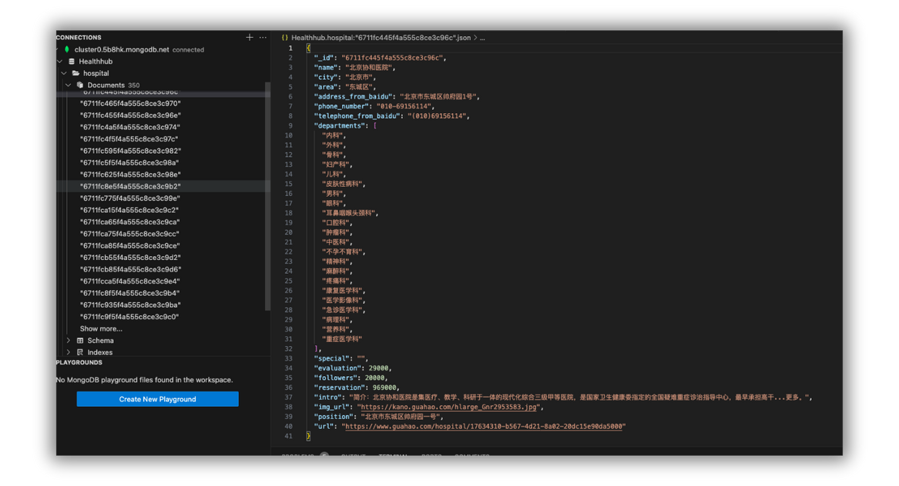
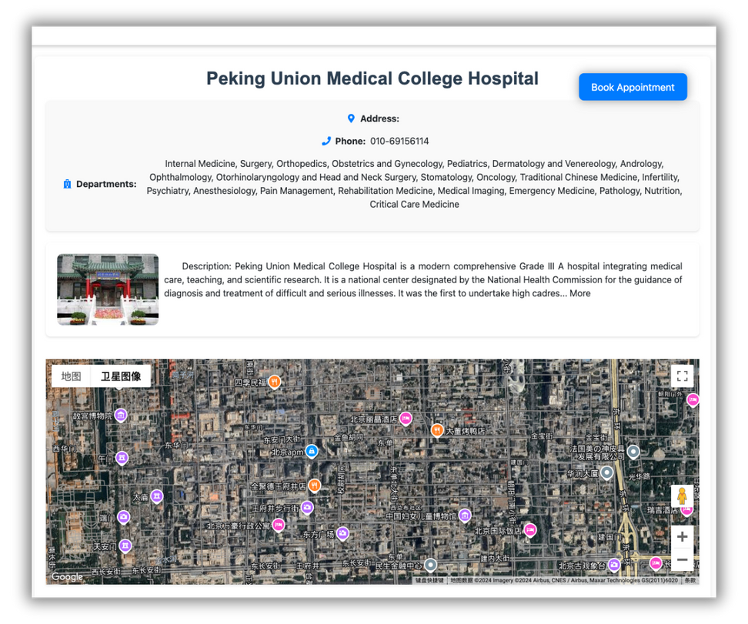
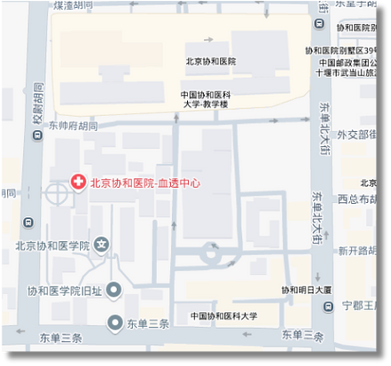



HOSPITAL INFO
HOSPITAL DETAIL IN
MONGODB
Each hospital entry includes key information such as the hospital's name, city, area, address, phone number, and a list of medical departments and so on.When displaying, we use google map API to show the exact location based on the address.
zoom in to see the details

Slide 8




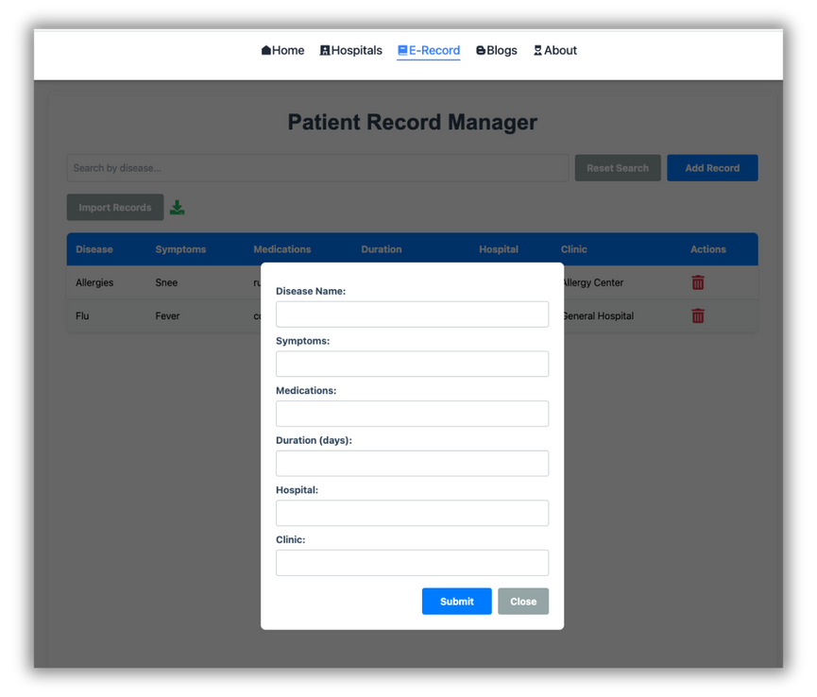
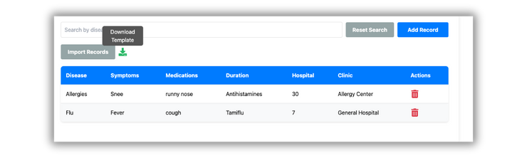
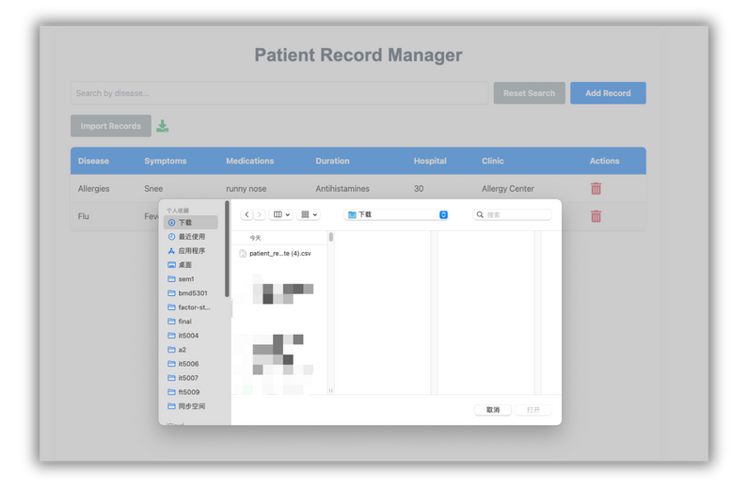


ELECTRONIC MEDICAL INFO
ADD
Input/Download/Import EXCEl
DELETE
MODIFY
CHECK

Slide 9


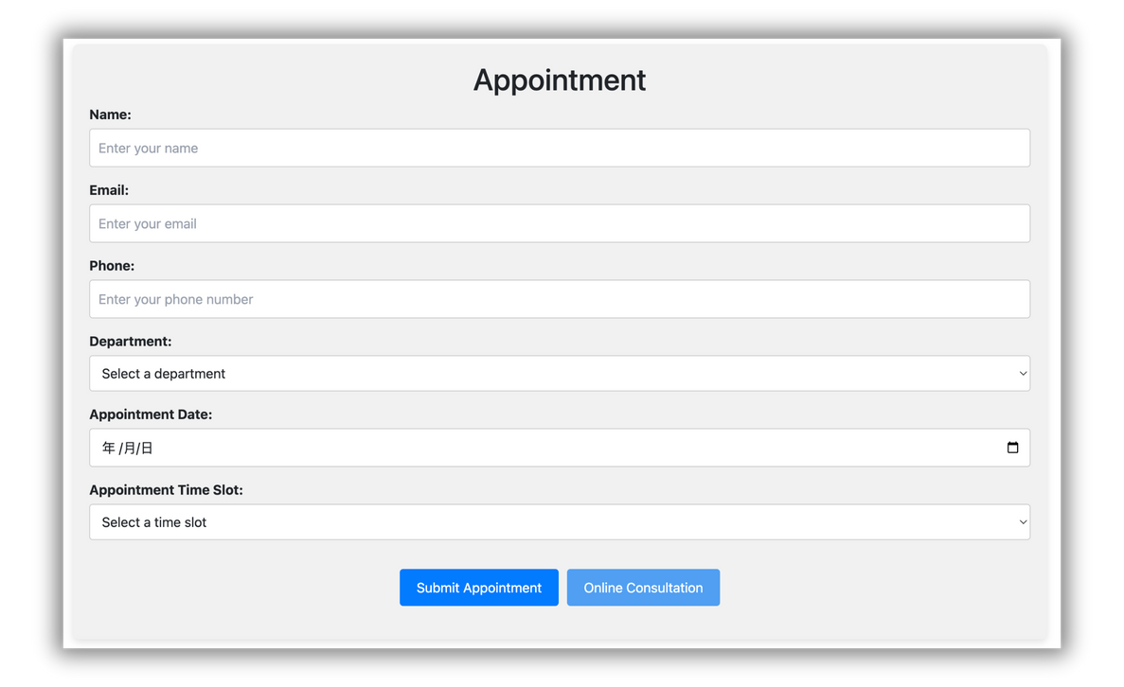
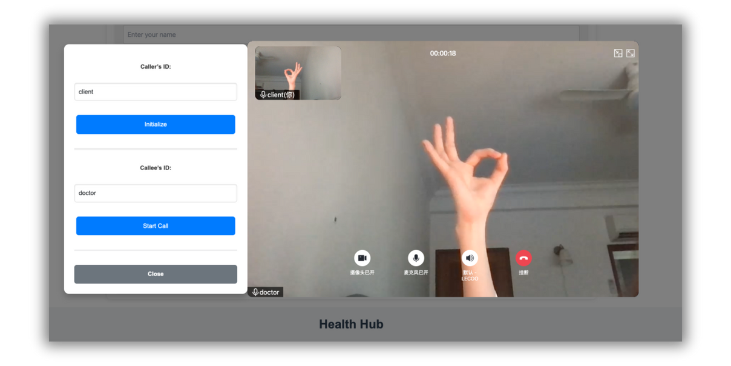
APPOINTMENT
& CONSULTING
In the detailed hospital page, you can directly make an appointment to meet doctors in person or video consultation associated with the hospital. Whether in daily life or during situations like a pandemic, online consultations for the elderly are considered a crucial component. Therefore, we use Tencent Cloud's API to create an online video module, enabling users to communicate directly with doctors.
Appointment
Consulting with doctor

Slide 10

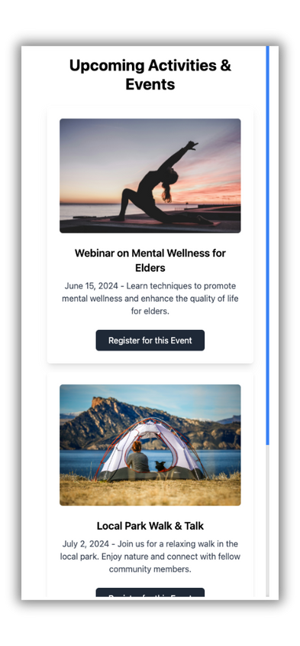
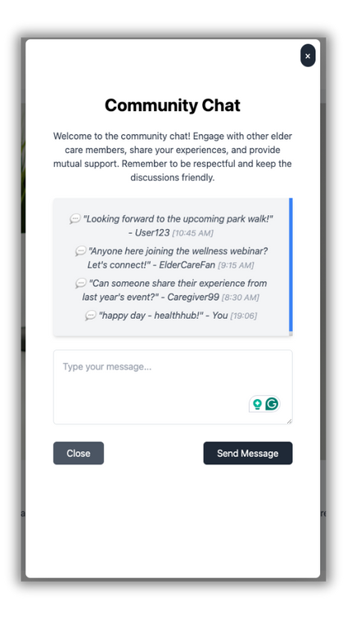
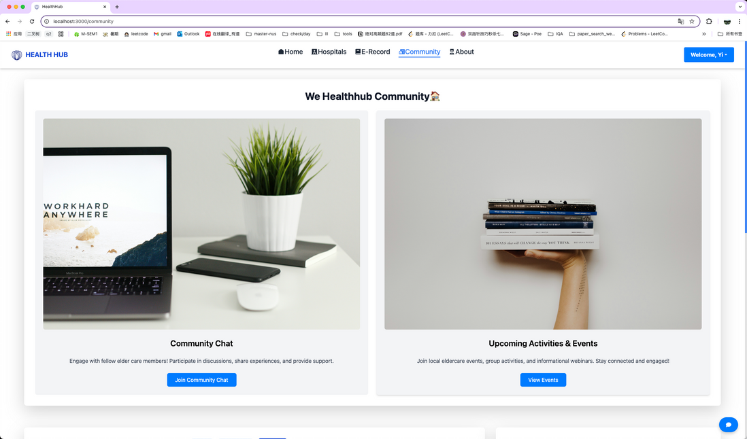
COMMUNITY
PART 1:
The community chat and events section is designed with a focus on an interactive frontend to enhance community building. Users can share their experiences and feelings, creating a platform for real-time interaction.
The upcoming activities and events section will be regularly updated with activities and elder care services that seniors can participate in, along with a booking feature to make event reservations seamless and user-friendly.
Backend: chat(add), event(add)
Frontend: User-friendly display

Slide 11
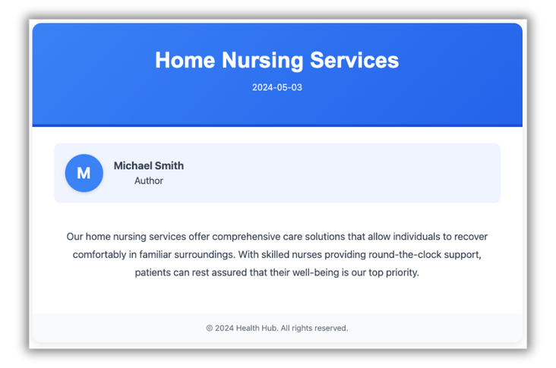
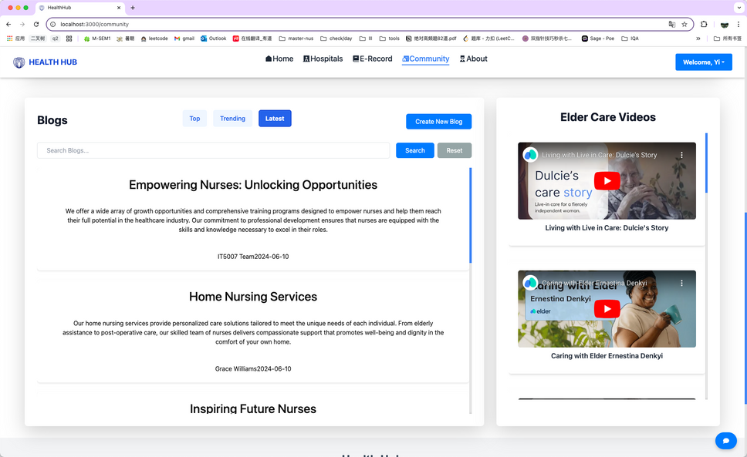
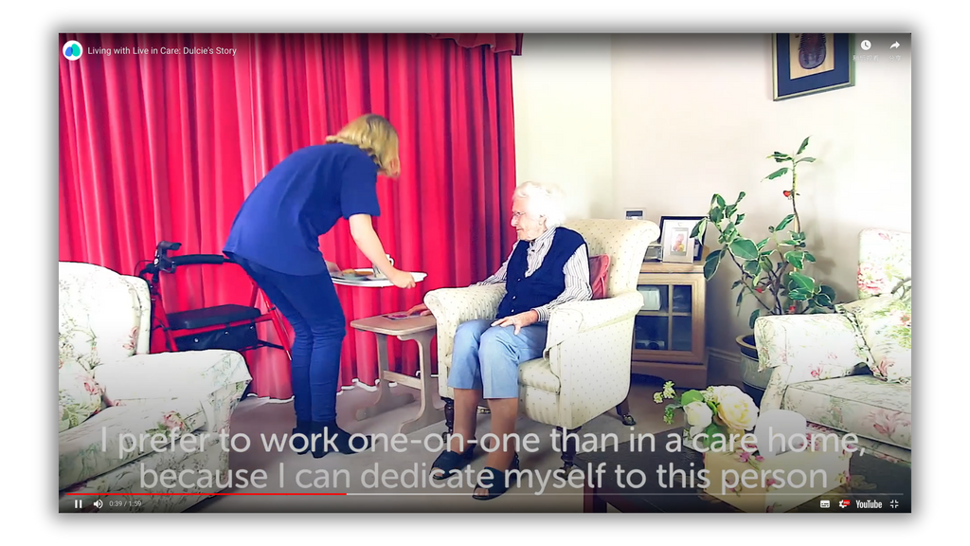
COMMUNITY
PART 2:
Blogs: Users share experiences with HealthHub-linked hospitals, including events and treatments. Supports search and three categories: top-rated, trending, or date.
Videos: Use YouTube API to fetch elder care and healthcare videos. Display them on the right as supplementary resources.
Blog detail
Healthcare video
Backend: Store blogs(add/search/sort)
Frontend: User-friendly blog display
responsive video player

Slide 12
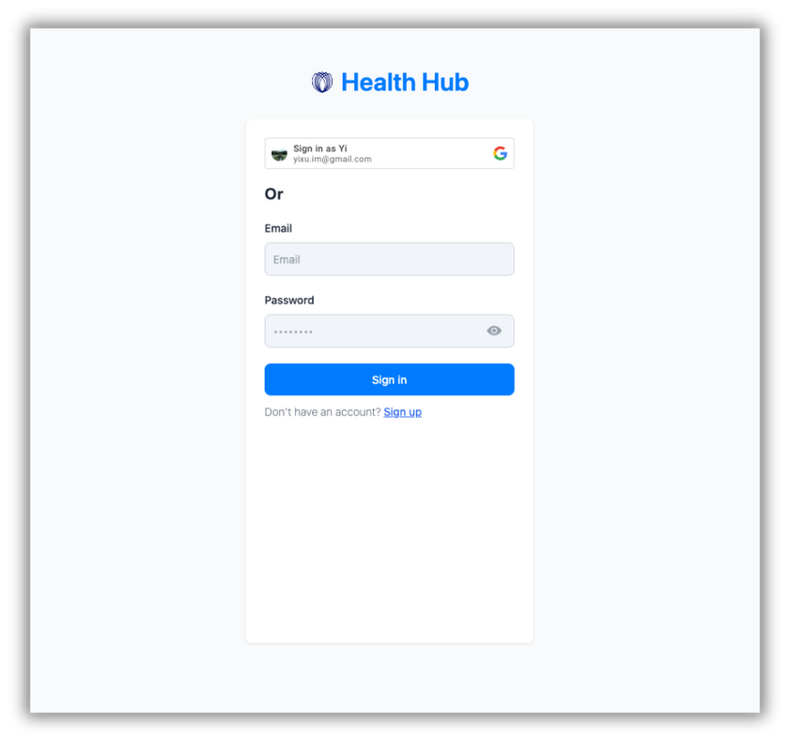
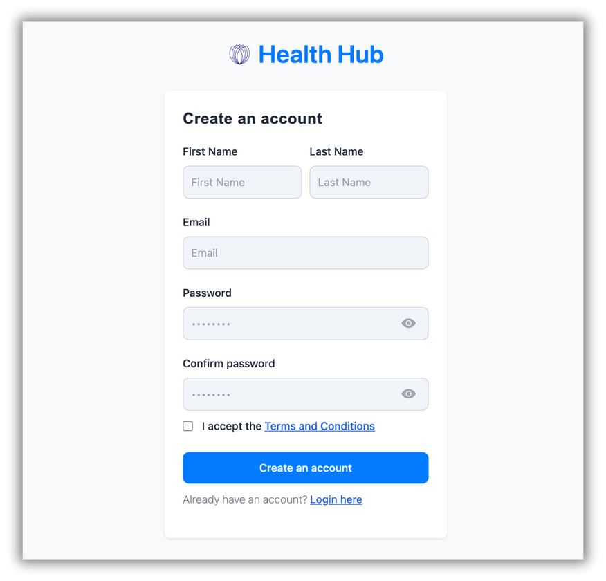

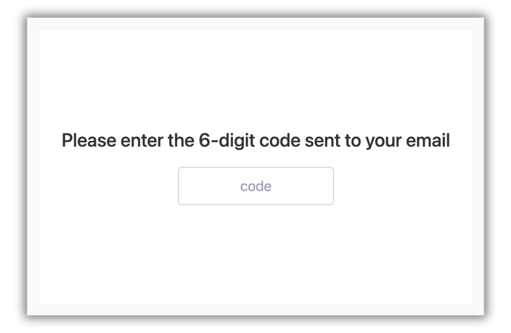
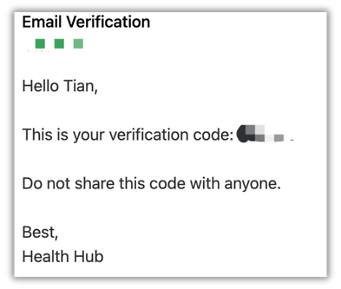

SIGN IN&OUT&UP
CONVENIENCE
& SAFETY
Convenience: Users can log in directly using their Google account or register with another email password.
Safety: If you choose the second way, you will receive an OTP from the email provided to do the validation. And the password is also salted, even the administrator cannot view the password.

Slide 13




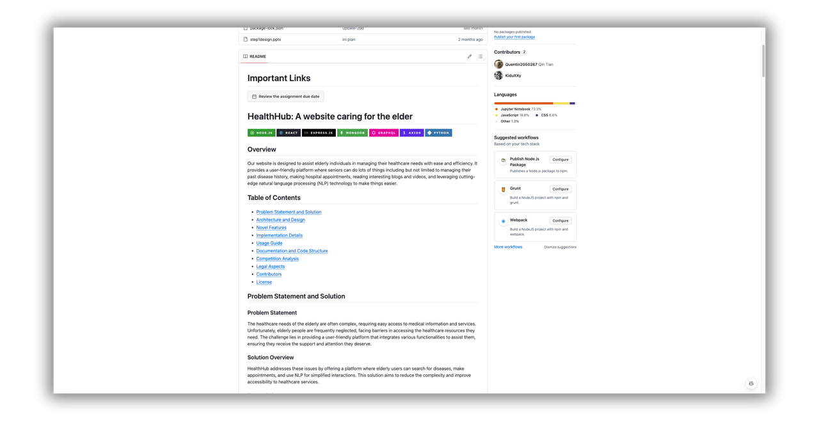

PRESENTATION OF OUR WEBSIT
our github link: https://github.com/IT5007-2410/course-project-group-1

Slide 14












CONCLUSION OF OUR TECH STACK

Slide 15

CONCLUSION OF DIFFERENTIATIONS
01
02
03
Disease Information: Access to detailed resources and guides for understanding various health conditions.
Hospital Appointment Scheduling: Seamless booking of healthcare appointments.
Online Consultations: Virtual consultations with medical professionals.
Medication and Treatment Management: Digital records of prescriptions and treatment plans post-appointment.
Community Engagement: A dedicated space for the elderly to share experiences, find information about caregiving activities, and offer mutual support.
TARGETED USER BASE & USE CASES
SPECIALIZED CHATBOT
ONE-STOP SERVICE
Addressing the elderly’s needs for disease-related information and medical care
NLP, fine-tuned customized chat-robot for elderly health care
Providexs an integrated platform that offers a wide range of functionalities

Slide 16


THANK YOU
SO MUCH

